Slide 1
How Common Systemic Diseases Affect the
Neurological Condition
Stephanie Essma
Alverno College
MSN 621
Spring 2010

Slide 2

Table of Contents
Introduction
Diabetes Mellitus
Renal Disorders
Case Study’s
References
Use the Navigation Keys in the bottom right to work through the Tutorial
The house key will bring you back to this page for easy routing.
If you come to an Underlined word, hover the cursor over it or click for more information!
(Microsoft Word 2010)

Slide 3
Introduction
(Microsoft Word 2010)
Many medical conditions are systemic and affect all organs in the body.
When conditions cause central and peripheral nervous system complications, nurses need to recognize early signs and how it will affect a patients survival and quality of life.
The function of organ systems working together is to keep the brain alive.
(Garcia, Strub, Wiesberg, 2008)

Slide 4

Peripheral Nervous System
Carrying Information from Brain to the body:
MOTOR MESSAGES
The PNS Connects the CNS to the rest of the body through nerves.
Carrying Information from Body to the Brain:
SENSORY MESSAGES
(Wikipedia, 2010)
(Microsoft Word Images,2010)

Slide 5
Central Nervous System
Brain:
Processes information from Spinal Cord
Together, the coordinate all bodily functions
Spinal Cord: receives information from the PNS
(Wikipedia, 2010)
(Microsoft Word Images,2010)

Slide 6
Introduction
Many neurological problems occur in the critically ill patient but may also occur from common health problems.
Either way, the problems are serious and may cause significant decrease in brain function, morbidity, or mortality.
This presentation will address how common health problems influence a patient’s neurological state.
(Garcia, Strub, Wiesberg, 2008)
(Microsoft Word Images,2010)

Slide 7
When Medical conditions are systemic, they affect all organs in the body.
Correct. “Systemic” is defined as “Relating to or affecting the entire body”
Incorrect. “Local” does not affect all bodily organs.
TRUE
FALSE
(Microsoft Word Images,2010)

Slide 8
An older woman is having a difficult time with her sense of taste, she says “I can not taste like I used to.” Is this woman experiencing a problem with her PNS or CNS, or both?
Yes! The PNS is responsible for the nerves that interpret the 5 senses
Try again. There is a problem with the transmission from the body to the brain.
PNS
CNS
No try again!
Both
(Microsoft Word Images,2010)

Slide 9
Let’s Start with
Diabetes
Mellitus

Slide 10
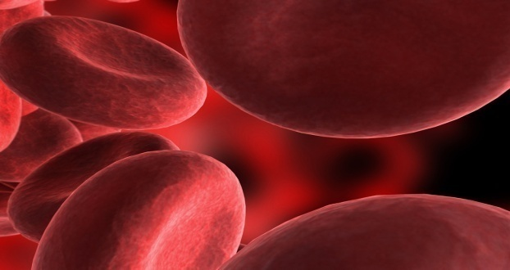
Diabetes Mellitus
Diabetes is a chronic disease characterized by abnormally high levels of sugar glucose in the blood.
  Due to either inadequate production of insulin from the pancreas OR decreased sensitivity of cells to insulin.
Incidence and prevalence of diabetes increase with age and has a genetic predisposition
It may also be influenced by lifestyle factors such as poor appetite, lack of exercise, and obesity.
(Garcia, Strub, Wiesberg, 2008)
(Wikipedia, 2010)
(Microsoft Word Images,2010)

Slide 11

Diabetes Mellitus
Age is a factor with diabetes because older people tend to
  Have coexisting illnesses
  Take drugs that interfere with glucose metabolism
  Tend to have an increase in weight
  Decrease their physical activity
  Have a poor diet
All of these issues make elderly more susceptible to health problems.
(Wikipedia, 2010)
(Meneilly, 2010)
(Microsoft Word Images,2010)

Slide 12

Diabetes Mellitus
Since obesity is one of most influential risk factors of diabetes, we should understand how damage is done through inflammation.
“Obesity is associated with chronic low-level inflammation” (Wellen, 2009).
Obesity itself overloads the functional capacity of the Endoplasmic Reticulum (ER), the stress on the ER leads to activation of inflammatory pathways, resulting in insulin resistance.
(Meneilly, 2010)
(Wellen,2009)
(Microsoft Word Images,2010)

Slide 13
Diabetes Mellitus
Click to watch how Obesity causes Diabetes
Obesity
ER Stress
Activation of Signaling Cascade
Inflammation
Insulin Resistance
Diabetes
(Meneilly, 2010)
(Wellen,2009)

Slide 14
Diabetes Mellitus
The presence of inflammation is evident in DM by increased levels of proinflammatory cytokines such as:
      C-Reactive Protein
      Tumor Necrosis Factor (found in adipose tissue)
      Leukocytes
      This inflammation leads to many other bodily and Neurological Complications.
(Wellen,2009)
(Wikipedia, 2010)

Slide 15
Can you remember the proinflammatory Cytokines that will be increased in the blood with Diabetes Mellitus?
Click on the correct ones.
CRP
TNF
Leukocytes

Slide 16
Diabetes Mellitus
Complications of Diabetes Mellitus (DM) that interfere with normal neurological functions include:
  Atherosclerotic disease
    May cause Strokes
  Hypoglycemia
  Ketoacidosis
  Hyperosmolarity
  Retinopathy/Vision loss
    Leads to the most common complication : Neuropathy
Lead to Encephalopathy
(Garcia, Strub, Wiesberg, 2008)
(Wikipedia, 2010)

Slide 17
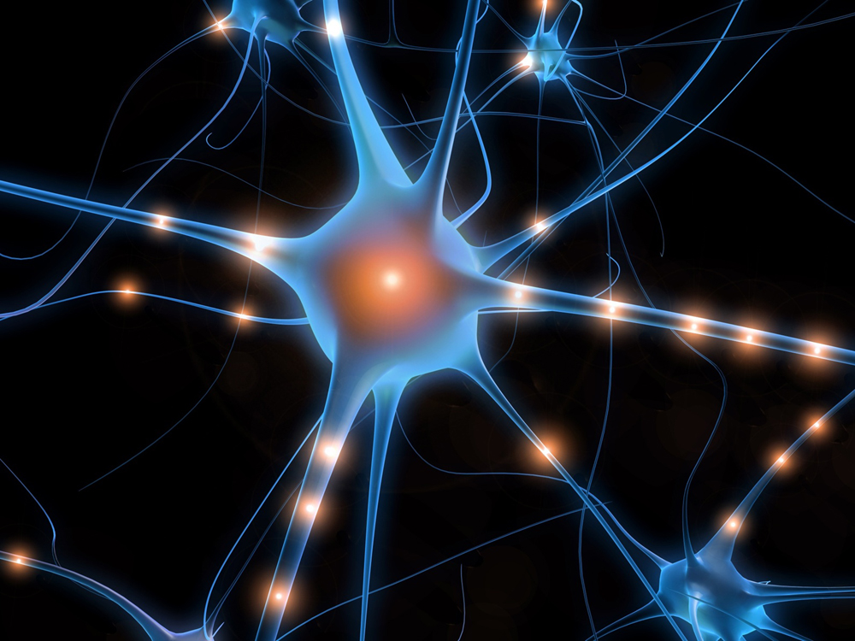
Diabetes Mellitus
Diabetic Neuropathy: a nerve disorder that results in altered nerve function.
  Patients with Diabetic Neuropathy will complain of numbness, tingling and pain in their extremities (fingers and toes) due to damaged nerve endings.
  Over time, neuropathy will work inward to larger bodily organs.
  Treatment: Tightly controlled blood sugar levels.
(Garcia, Strub, Wiesberg, 2008))
(Microsoft Word Images,2010)

Slide 18
Diabetes Mellitus
Mechanism of Neuropathy is not fully understood however one hypothesis states it may be due to Oxidative Stress.
  The Hypothesis is, DM is a hypermetabolic state leading to elevated intracellular glucose levels.
  These sugars react with Reactive Oxygen Species (ROS)
  Leading to a cascade that ultimately produces more Free Radicals.
  Glucose production itself also creates free radicals as a byproduct of ATP production.
  Result: Accelerated Free Radical Production resulting in Nerve Dysfunction/Death
(Goldberg, 2009)
(Wellen,2009)

Slide 19
Diabetes Mellitus: Neuropathy
Increased Intracellular Glucose
Start Clicking to Learn Physiology
Nerve Dysfunction and Death
Sugars + ROS = Carbonlys
OXIDATIVE STRESS
Carbonyls + Proteins/Lipids =
Glycoxidation or Lipodidation Byproducts

Slide 20
A man comes in to the free clinic with the symptoms listed below. Can you identify the signs of Neuropathy?
His feet are sensitive to touch
The correct STAY the incorrect FLY away!
His legs are tingling
He is having pain in his lower extremities
He has significant skin breakdown on his feet
He is crying because he missed his bus
This is not a sign of neuropathy.

Slide 21
Accelerated Free radical production ultimately results in…
Nerve Dysfunction
Cell Death
Neuropathy

Slide 22
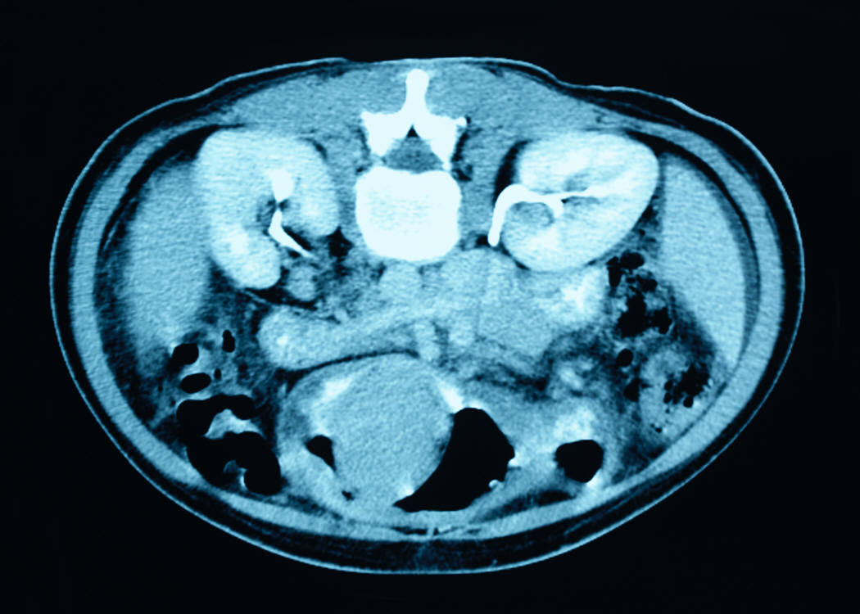
And now to Renal…
(Microsoft Word Images,2010)

Slide 23
Renal Disorders
Renal impairment can be directly related to neurological complications.
CNS dysfunction occurs when the kidney’s glomerular filtration rate drops below 10% of normal (90-120 ml/min).
Kidney failure effects a persons Neurologic condition more severely when complications are acute.
  Uremic Encephalopathy is common and can be caused by many renal disorders. It is capable of damaging both the PNS and CNS.
(Microsoft Word Images,2010)
(Bucurescu, 2008) (Garcia, Strub, Wiesberg, 2008)
(Wikipedia, 2010)

Slide 24
Renal Disorders
Uremic Encephalopathy is a brain disorder that develops in patients with acute or chronic renal failure
  Symptoms occur when creatinine clearance (CrCl) falls below 15ml/min.
  Occurs when toxins build up that are normally cleared by the kidneys.
  Symptoms may be as mild as fatigue and memory loss, or as severe as seizures and coma.
  Uremic Encephalopathy, if treated and diagnosed promptly, can be reversed with dialysis.
  Renal transplantation may be required in more severe prolonged cases.
(Bucurescu, 2008)
(Garcia, Strub, Wiesberg, 2008)

Slide 25
Renal Disorders:
Uremic Encephalopathy Hypothesis
Click to see more!
Renal Impairment causes
Na/K pump important for neurotransmitter releases
Uremia slows and decreases Na/K Pump activity by interfering with Calcium
transport
Increase in Toxins/ Uremia due to slowing in filtering
Decrease in Neurotransmission due to increase in Ca and toxins
Encephalopathy
Decrease in Brain
Metabolic
Activity
Decrease in Brain
Oxygen Consumption
(Bucurescu, 2008)

Slide 26
Case Study: Your grandpa has been very drowsy, slow to answer simple questions, and can not concentrate. You drive him to the doctor. Labs are drawn and you return the next day for the results. His GFR is 40% and his creatinine Clearance is 14 ml/min. Are his results within Normal Limits?
Incorrect. Normal Creatinine Clearance for a male is 60-110 ml/min.
Correct! Both results are very low. Normal GFR is 90-120ml/min and CrCl for a man is 60-110 ml/min
YES
NO

Slide 27
Case Study: After hearing the results, you suspect Uremic Encephalopathy. What is the best treatment for this type of disease?
Incorrect. This is only true in the advanced stages or Uremic Encephalopathy.
Try again. Uremic Encephalopathy is not usually associated with pain.
Transplant
Pain Medication
Correct! Dialysis is the Gold Standard for acute Uremic Encephalopathy.
Incorrect. He is already too lethargic.
Dialysis
Sleep

Slide 28
In the pathology process of Uremic Encephalopathy, what is the initial result from renal impairment leading to uremic encephalopathy?
Increase in Toxins/ Uremia due to slowing in filtering
Uremia slows and decreases Na/K Pump activity by interfering with Calcium
transport
Yes! Direct effect of kidney impairment
Decrease in Brain
Oxygen Consumption
Close! But try again.
Not the first problem.
Decrease in Brain
Oxygen Consumption
Decrease in Brain
Metabolic
Activity
This is a late result
Not Quite!

Slide 29
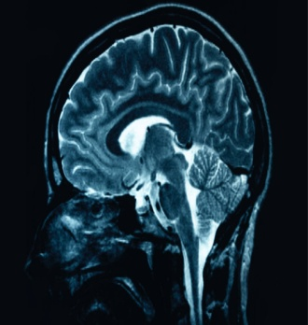
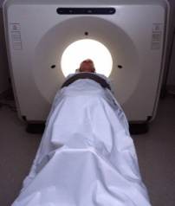
Renal Disorders: Genetically acquired diseases affecting both renal and Nervous System
Von Hippel-Lindau disease (VHL) is a renal disorder characterized by tumors in the CNS and Renal System.
  Autosomal dominant trait
  The earliest clinical sign appears as vision changes at the average age of 25.
  Brain Lesions are often found by age 30.
  MRI’s, renal CT’s and ultrasounds are needed to track disease progression.
  Genetic testing can be done to find the pathogenic mutation on the VHL gene found on chromosome 3 to help increase life expectancy
(Kaelin, 2007)
(Garcia, Strub, Wiesberg, 2008)
(Microsoft Word Images,2010)

Slide 30
Case Study #1
One of your patients is a 65 year old woman named Sally. she weights 220 pounds, she does not exercise because of a “bad hip” and her blood sugar is 235 and her CRP is elevated upon admission. She has been concerned about constant foot pain and vision loss. What of these symptoms makes you suspect Diabetic Neuropathy?
Her Weight
Blood sugar
Her age
CRP
Pain and vision loss
Decrease in physical activity

Slide 31
Case Study #2
Sally has many questions and asks what is the main cause of diabetic neuropathy and what is the best way to treat it??
A. High levels of Blood Glucose Levels and treatment is tight blood sugar control.
B. Poor diet and treat with a pancreas transplant.
Not this time, try again.
C. The cause is unknown so it can not be treated.
Probably not this one, try again.

Slide 32
Case Study #3
Bob is a patient hospitalized for cardiac issues. His labs are drawn and you’re surprised and suspect a decrease in renal function. What lab results would make you think this??
GFR
Blood Glucose
Creatinine Clearance
Leukocytes

Slide 33
Case Study #4 you have a patient who’s parents both have Von Hippel- Lindau disease. Which of the following key points would you teach this patient??
VHL affects both the renal and central nervous system
Recessive trait
No, it is an Autosomal Dominant Trait.
It is characterized by tumors in the CNS and Renal system
It is a genetically acquired disease
It should be monitored closely by CT’s and MRI’s

Slide 34
Thank you
for
participating!
(Microsoft Word Images,2010)

Slide 35
Referances
Bates D., & Bates D.J. (1998). Neurology and the kidney. Journal of Neurological Neurosurg Psychiatry, 65, 810-821.
Bucurescu, G. (2008). Uremic encephalopathy. Retreived from http://emedicine.medscape.com/article/1135651-overview/.
Garcia, C., Strub, R., & Wiesberg, L.A. (2008). Essentials of clinical neurology: Chapter 22, Neurologic Complications of systemic diseases. Retrieved from: psychneuro.tulane.edu/neurolect/
Goldberg, R.B., (2009). Cytokine and cytokine-like inflammation markers, endothelial dysfunction and imbalanced coagulation in development of diabetes and its complications. Journal of Clinical Endocrinology & Metabolism, 9, 3171-3182. Retrieved from Inflammation & diabetes, interventions, natap.org/2009/HIV/090609_01.html.
Kaelin, W.G. (2007). Von hippel-lindau Disease. Journal American Society of Nephrology, 11, 2703-2711.
Meneilly, G. (2010). Pathology of diabetes in the elderly. Journal of the American Geriatric Society, 4, 25-28.
Microsoft Word, Office clip art. Retrieved April 25,2010.
Wellen,K. (2009). Inflammation, stress, and diabetes. The Journal of Clinical Investigation, 5, 115.
Wikipedia, the free encyclopedia. Retrieved: April 24, 2010, from http://en.wikipedia.org/wiki/

Slide 36

Nice work!
Click on the thumb to go back!
(Microsoft Word Images,2010)

Slide 37
Perfect!
Click here to go back!
(Microsoft Word Images,2010)

Slide 38

You got it!
Click on the Parrot to go back
(Microsoft Word Images,2010)

Slide 39
Try again.
Click on the face to return.
(Microsoft Word Images,2010)

Slide 40
Great Job!
Click on the girl to go back!
(Microsoft Word Images,2010)

Slide 41

Correct!
Click the Smiley face to continue.
(Microsoft Word Images,2010)

Slide 42

Correct!
Click on the TIGER to go back
(Microsoft Word Images,2010)

